Slide 1

PGB Session
28 August 2025
Ms. Katherine Escobar
NIEMOpen Project Governing Board Chair

Slide 2
CALL TO ORDER
Called to order the regular virtual meeting of the NIEMOpen Project Governing Board at 2 PM, 28 August 2025.
2

Slide 3
VENUE
PGB Meeting
28 Aug 2025
Virtual Meeting 2-4 PM EST
– Virtual: MS TEAMS
The next meeting will be conducted on ZOOM
Microsoft Teams 28 August 2025 PGB Meeting
Microsoft Teams
Join the meeting now
Meeting ID: 993 992 894 975
Passcode: Gs9YZ7DH
Dial in by phone
+1 410-874-6749,,878640958# United States, Odenton
Find a local number
Phone conference ID: 878 640 958#
PGB Minutes & documents: https://github.com/niemopen/oasis-open- project/tree/main/pgb-meeting-minutes

Slide 4
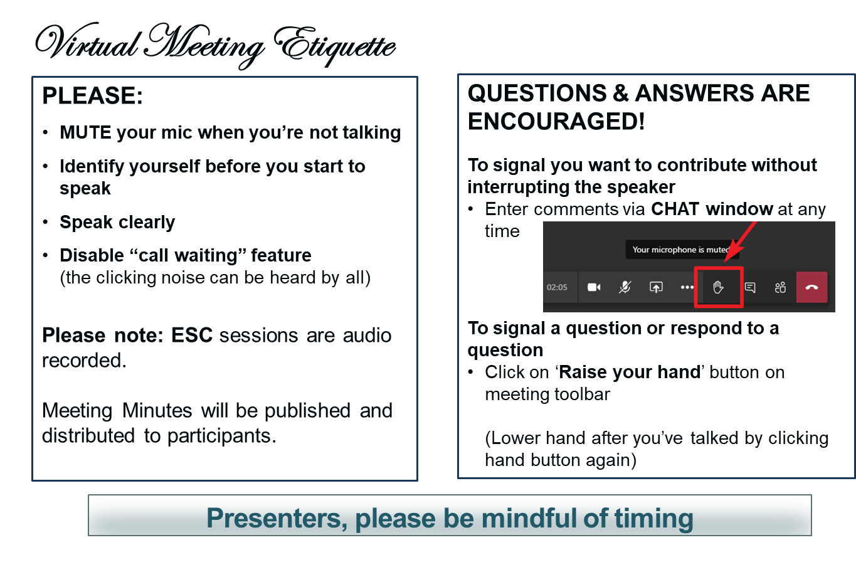
MAKING THE MOST OF OUR SESSION

Slide 5
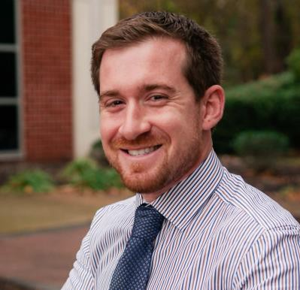
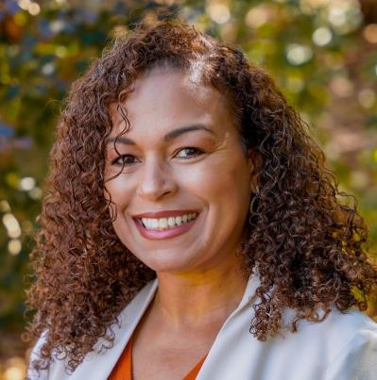
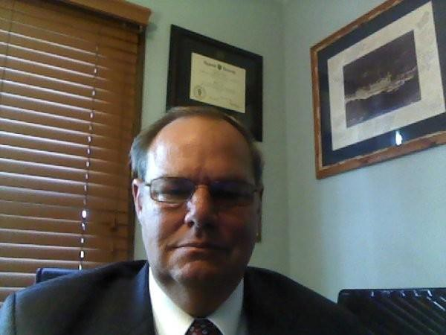
NOTE TAKER
The PGB Executive Session is being recorded on MS TEAMS. A link to the recording will be provided and meeting minutes will be posted on the NIEMOpen Git Repo once approved: https://github.com/niemopen/oasis-open-project/tree/main/pgb-meeting-minutes
Meeting support, note takers: Aubrey Beach
aubrey.l.beach.ctr@mail.mil
Shunda Louis
shunda.r.louis.ctr@mail.mil
Stephen Sullivan
stephen.m.sullivan14.ctr@mail.mil

Slide 6
ROLL CALL
PGB Sponsor Voting Members (10):
All Purpose Networks (APN)
Bureau of Justice Statistics (BJS)
Department of Defense Joint Staff J6 (DoD JS J6)
Department of Homeland Security Science & Technology (DHS S&T)
Georgia Tech Research Institute (GTRI)
Integrated Justice Information Systems Institute (IJIS)
Commonwealth of Virginia, Office of Data Governance and Analytics (ODGA)
Criminal justice Information Systems Division (CJISD), Federal Bureau of Investigation
National Association for Justice Information Systems (NAJIS)
National Institute of Justice (NIJ)
PGB Expert Voting Members (2)
NBAC TSC
NTAC TSC
NMO TSC (pending new Co-Chairs)
PGB Expert NON-Voting Members (4)
Quorum: 6
Full Majority Vote “Approval” 6
Notes:
Voting Members
Mr. Jim Herbert - All Purpose Networks (APN)
Ms. Erica Smith - Bureau of Justice Statistics (BJS)
Ms. Katherine Escobar - Department of Defense Joint Staff J6 (DoD JS J6)
Ms. Christina Bapst-Stump - Department of Homeland Security Science & Technology (DHS S&T)
Mr. Gary Egner - Equivant
Mr. John Wandelt - Georgia Tech Research Institute (GTRI)
Ms. Maria Cardiellos - Integrated Justice Information Systems Institute (IJIS)
Mr. Payton Lamb - Commonwealth of Virginia, Office of Data Governance and Analytics (ODGA)
Ms. April Michell - Criminal justice Information Systems Division (CJISD), Federal Bureau of Investigation
Mr. Tom Welch - National Association for Justice Information Systems (NAJIS)
Ms. Erin Partin - National Institute of Justice (NIJ)
Expert Voting Members
NBAC TSC - Mr. Thomas Krul (National Defence Canada)
NTAC TSC - Dr. Scott Renner (MITRE)
NMO TSC – Ms. Beth Smalley (Joint Staff J6 DSD)
PGB Expert Non-Voting Members(4)
NBAC TSC – Mr. Kamran Atri (A4Safe),
NBAC TSC Mr. Paul Wormeli
NTAC TSC – Mr. Brad Bolliger (EY)
NMO TSC- Ms. Darcy Staley (JS J6)

Slide 7
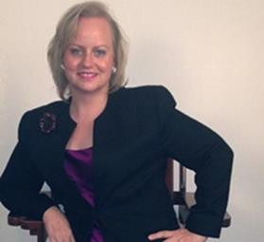
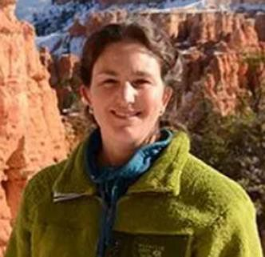
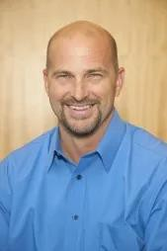

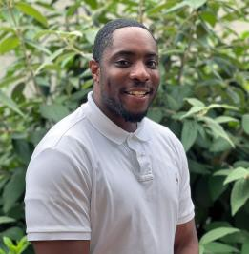
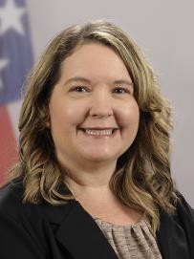
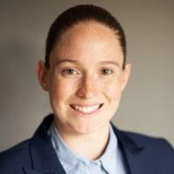
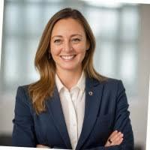
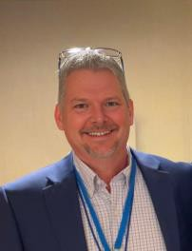
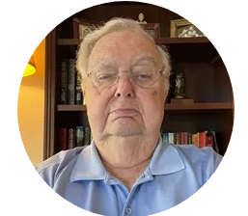
PGB APPOINTED VOTING MEMBERS
Mr. Payton Lamb Data Engineer Commonwealth of Virginia Office of the secretary of Administration
Office of Data Governance and Analytics
Ms. Katherine Escobar
PGB Chair Deputy Division Chief, Data and
Standards Division at Joint Staff J6 and NIEM Managing Director
Ms. Christina Bapst-Stump
Science and Technology Directorate,
US Department of Homeland Security
Mr. John Wandelt Principal Research Scientist, Georgia Tech Research Institute
Mr. Paul Wormeli Co-Chair, NIEM Business Architecture Committee TSC
Ms. April Mitchell FBI It Specialist and Technical Lead of Data Standards in the Criminal Justice Information Services (CJIS) Division
Ms. Erin Partin Data Scientist, Office of the Principal Deputy Director, National Institute of Justice (NIJ)
Ms. Erica Smith Data Scientist, Unit Chief – Law Enforcement Incident-Based Statistics Unit, Bureau of Justice Statistics (BJS)
Mr. Tom Welch Director of Information Technology OHIO HIDTA –
Including Northern KY & Western PA
Mr. James T. Herbert
VP, CMO
APN Software

Slide 8
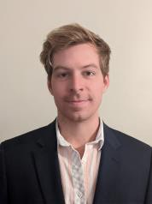
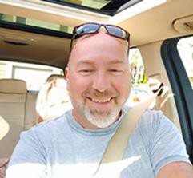
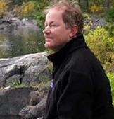
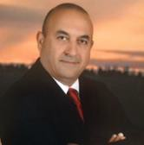
PGB EXPERT VOTING MEMBERS & NON-VOTING MEMBERS
PGB EXPERT VOTING MEMBERS
Technical Steering Committees
PGB EXPERT NON-VOTING MEMBERS
Technical Steering Committees
Mr. Kamran Atri Co-Chair, NIEM Business Architecture Committee TSC
Mr. Paul Wormeli Co-Chair, NIEM Business Architecture Committee TSC
Mr. Brad Bolliger Co-Chair, NIEM Technical Architecture Committee TSC
Mr. Thomas Krul Co-Chair, NIEM Business Architecture Committee TSC
Dr. Scott Renner Co-Chair, NIEM Technical Architecture Committee TSC

Slide 9
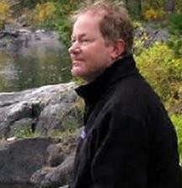
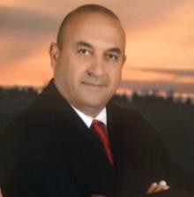

NMO, NBAC, & NTAC TSC CO-CHAIRS & OASIS MAINTAINERS
TSC | Approved (TSC CHAIRS)
NMO TSC | TBD
NBAC TSC | Mr. Kamran Atri & Mr. Thomas Krul, Mr. Paul Wormeli
NTAC TSC | Dr. Scott Renner & Mr. Brad Bolliger
GitHub Repos | Primary | Alternates
NIEM Open | Ms. Christina Medlin, Mr. Paul Wormeli, Mr. Brad Bolliger, Mr. Aubrey Beach (expiry 10/25) | Mr. Tom Carlson, Ms. Shunda Louis (expiry 10/25), Mr. Steve Sullivan (expiry 10/25))
NTAC-Admin | Dr. Scott Renner, Mr. Brad Bolliger | Mr. Aubrey Beach, Mr. Tom Carlson, Mr. Jim Cabral, Ms. Christina Medlin, Ms. Shunda Louis (expiry 10/25)
NBAC-Admin | Mr. Steve Sullivan (expiry 10/25), Mr. Aubrey Beach (expiry 10/25), Paul Wormeli, Kamran Atri, Thomas Krul | Ms. Shunda Louis (expiry 10/25), Ms. Christina Medlin
NMO-Admin | Mr. Aubrey Beach (expiry 10/25), Mr. Paul Wormeli, | Mr. Steve Sullivan (expiry 10/25) (expiry 10/25), Ms. Shunda Louis
NTAC
TSC
NBAC
TSC
NMO TSC
TBD
10

Slide 10
PROPOSED 28 August 2025 PGB AGENDA
Call to Order
Admin
TEAMS Link
Meeting Etiquette
Note Takers
Roll Call & Introductions
Announcements
PGB Voting Members (Sponsors) & PGB Expert Voting Members (TSCs) & PGB Non-Voting Members (TSC Co-Chairs)
TSC Co-Chairs & NIEMOpen Maintainers
Approval of Agenda
Approval of PGB Meeting Minutes from 28 May
Announcements
Around-the-Horn – PGB Voting Member Comments
2025OASIS Staff / NIEMOpen Administrator
Q2 2025 Financial Snapshot – Cathie Mayo (OASIS)
Sponsor Update – Rita Petti/ Holly Peterson
CY 2025 Tasks
NIEM.gov Migration – Aubrey Beach
8 Oct NPC Meeting Update
13 Nov Reveal Summit Webinar Update
BREAK
Motions
Motion to nominate & elect new PGB Chair (s).
WORDS FROM THE NEW CHAIR
2. Motion to authorize $ 2000 for 8 October NPC Leadership Meeting.
3. Motion to approve PGB Meeting dates.
Co-Chair Discussion /Updates
NTAC Update – Mr. Brad Bolliger & Dr. Scott Renner
NBAC Update – Thomas Krul
Next Meeting Schedule
Other Business/Discussion
Questions/Adjourn

Slide 11
APPROVAL OF AGENDA
Chair: A Draft Agenda for the NIEMOpen 28 August 2025 Project Governing Board (PGB) Meeting was provided to PGB Voting Members as a readahead.
Chair: Are there any recommended changes to the agenda as distributed?
Chair: If there are no (further) changes, the agenda stands approved as
(corrected).
?
Approve
Approve as Corrected

Slide 12
APPROVAL OF 28 May 2025 PGB MINUTES
Chair: A Draft of the NIEMOpen 28 May 2025 PGB meeting minutes was provided to the PGB Voting/Expert Voting Members as a readahead: Please let me know now if you found any errors: xxxxxxxxxxxxxxxxxxxxxxxx
Chair: Are there any corrections to the minutes as distributed?
Chair: If there are no (further) corrections, the minutes stand approved as distributed (corrected).
?
Approve
Approve as Corrected

Slide 13
ANNOUNCEMENTS
PGB Chair nominations & election of new Chair – 28 August
Transition of NMO functions in progress
OASIS-GTRI contract in place
API 2.0
6.0 Training Updates
NDR v6.0 PS01 Special Majority Vote in progress
3 Statements of Use for Model Version 6.0 PS02 in progress as predicate for NIEM Model 6.0 OS candidate
8 October 2025 Co-Chair Meeting @ NPC
13 November Reveal Summit registration open

Slide 14

Election of New Chair , NMO TASK Transition - Big Picture,
IN PROGRESS
Functions/tasks that need to be transferred to “new” NMO secretariat or distributed across NIEMOpen
NMO Functions/Activities
Provides Overall Project Management & Oversight Support to PGB Chair
Sponsor Recruiting
OASIS Liaison
Project Strategic Planning
PGB Chair Secretariat
Provides NTAC & NBAC TSC Liaison
Provides NBAC TSC Secretariat
Provides Technical Help Desk Services
Provides Strategic Communications
Provides Domestic & International Marketing
Provides Event Planning & Execution
Provides Training Support
Git Repro Maintainers
NIEM.gov transfer/shutdown
Administers:
Social Media Accounts
NIEM Open.org website
AWS MEP Tool Hosting
LMS
Presswire
MEP Tool
JIRA/ Confluence
Admin of Git Repos
Yoast
Constant Contact
Nominations & Vote 28 August
NIEM OPEN
Chair
Project Governing Board
Technical Steering Committee
(NIEMOpen NMO)
Technical Steering Committee
(NIEMOpen NBAC)
Technical Steering Committee
(NIEMOpen NTAC)
Communications & Outreach
Subcommittee
NBAC Subcommittees
LEGEND
PGB
TSC
SUBCOMMITTEE
JOINT STAFF
Notes:
Slide updated 12/29/22
On 20 October 22 OASIS stood up NIEM Open Project. This Organization Structure was proposed and approved by the PGB on 20 October with exception of the two tiger teams shown which are currently being considered by the NBAC and NMO TSCs. The Project Governing Board (PGB) was established with membership from six Founding Sponsors (Joint Staff J6, Department of Homeland Security Science & Technology (DHS S&T), Georgia Tech Research Institute (GTRI), Equivant, sFractal, and the National Association of Justice Information Systems (NAJIS).
5.1 Overall guidance for the Project is provided by its Project Governing Board (or PGB). The PGB is composed of one voting member from each Project Sponsor who elects to appoint a PGB member, and (a) if the PGB has one or more Technical Steering Committees, one voting expert representative from each TSC, elected or appointed by that TSC,… The PGB may create additional non-voting PGB member seats for expert representatives to be elected by the TSC or appointed by the PGB (Open Project Rules - OASIS Open (oasis-open.org)
The PGB approved 3 Technical Steering Committees (TSCs) by resolution and their respective governance documents (NIEM Management Office TSC, NIEM Business Architecture Committee TSC, and NIEN Technical Steering Committee TSC) and appointed their respective Co-Chairs.
6. Technical Steering Committees - The PGB shall form a Technical Steering Committee (or TSC) by a resolution of the PGB. A Project’s TSC members shall be composed of the persons, selected in the manner, and chaired by such person as is provided by that resolution. The PGB must create and publish process documentation for each TSC, outlining the requirements for joining and voting in that TSC, consistent with these Rules (including Section 10), and shall specify whether the Chair(s) of the TSC are selected by the PGB, or by that TSC’s members. The TSC shall have the duties to advise the PGB and such others as are specified by the PGB, so long as consistent with these Rules and OASIS policies (Open Project Rules - OASIS Open (oasis-open.org).
The TSCs may establish Subcommittees and Tiger Teams. There were 17 former NIEM Domains (Communities of Interest (COIs)) at the standup of NIEM OPEN under the auspices of OASIS. The NBAC TSC is recommending these Domains transition as NBAC subcommittees as outlined in the NBAC TSC approved Governance Document. Each Domain will elect a Steward and/or Chairs and establish Standard Operating Procedures IAW OASIS rules.
In addition to Domains, the Harmonization Subcommittee is constituted under the NBAC TSC. This subcommittee is responsible for oversight of NIEM CORE (The NIEM core consists of data elements that are commonly understood and defined across domains, such as person, activity, document, location, and item. It’s governed jointly by all NIEM domains and the NIEM Harmonization Process.). https://www.niem.gov/about-niem/niem-model
Updating the NIEM core
If a data requirement isn't already found in the overall NIEM model and is applicable to many domains, it can be submitted through the NBAC for consideration for NIEM core. A primary function of the NBAC is to coordinate the ongoing harmonization process between NIEM core and domains.
Model harmonization
Harmonization is an ongoing process to ensure no duplication in the model as updates are made and it evolves to accommodate new community business requirements. The harmonization process integrates these new requirements while still ensuring data elements exist only once in the model. There are two types of harmonization, between domains and between NIEM core and domains.
Harmonization review process
Each domain has its own process for updating its data model, depending on the domain’s business needs and resources available.
For harmonization between NIEM core and domains, every new business requirement that's identified follows a review process, as follows:
Issue is identified and an initial assessment is conducted by the NIEM … developers or self-identified by the domain(s).
Issue is reviewed by the NBAC and is assigned to a team consisting of NBAC TSC members with knowledge, expertise, and/or vested interest in resolving the issue.
The NBAC team works to resolve the issue and provides a recommended solution.
The NBAC reviews the recommended solution and accepts, rejects, or defers it for more information, which the team then supports.
When the solution is accepted, NIEM lead developers will include it in the next release. https://www.niem.gov/about-niem/niem-model
The Executive Liaison Group is an informal advisory group composed of members of the former NIEM Executive Steering Committee and senior NIEM advocates. It serves in a consultive role to the PGB at the discretion of the PGB.
As of 12-27-2022, there are 1 NBAC TSC Tiger (Domain Management & Standing Rules) and 1 NMO TSC Standing Committee (Communications & Outreach) in the offing.

Slide 15

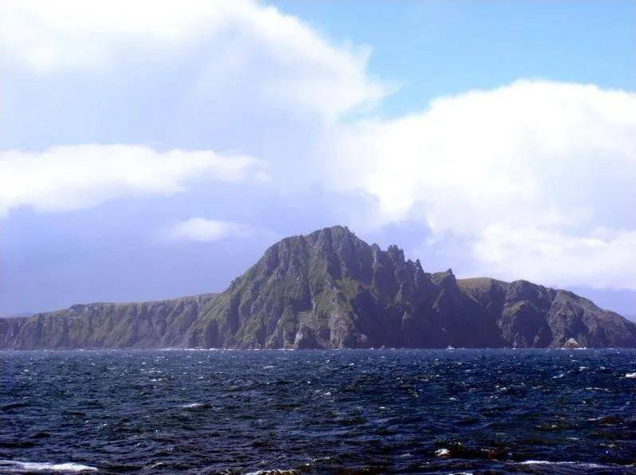
PGB MEMBERS: AROUND-THE-HORN

Slide 16

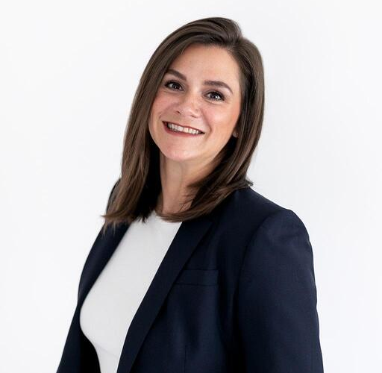
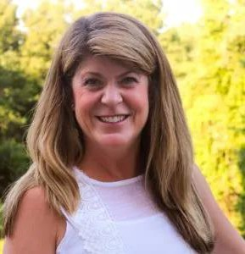
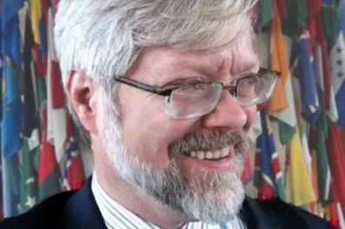
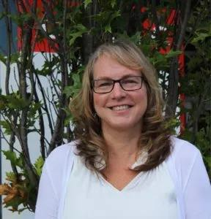
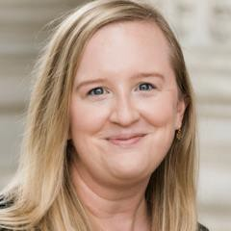
OASIS STAFF
Ms. Holly Peterson – OASIS Business Development Manager
Ms. Rita Petti – OASIS Director
of Business Development and
Partnerships.
Mr. James Bryce Clark –
OASIS General Counsel
Ms. Cathie Mayo – OASIS Chief Financial Officer
Ms. Kelly Cullinane – OASIS Senior Director of Standards Development
Ms. Jane Harnad – OASIS Head of Events

Slide 17
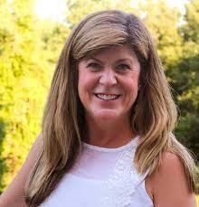
CY 2025 Q1 FINANCIALS
Ms. Cathie Mayo – OASIS Chief Financial Officer

Slide 18
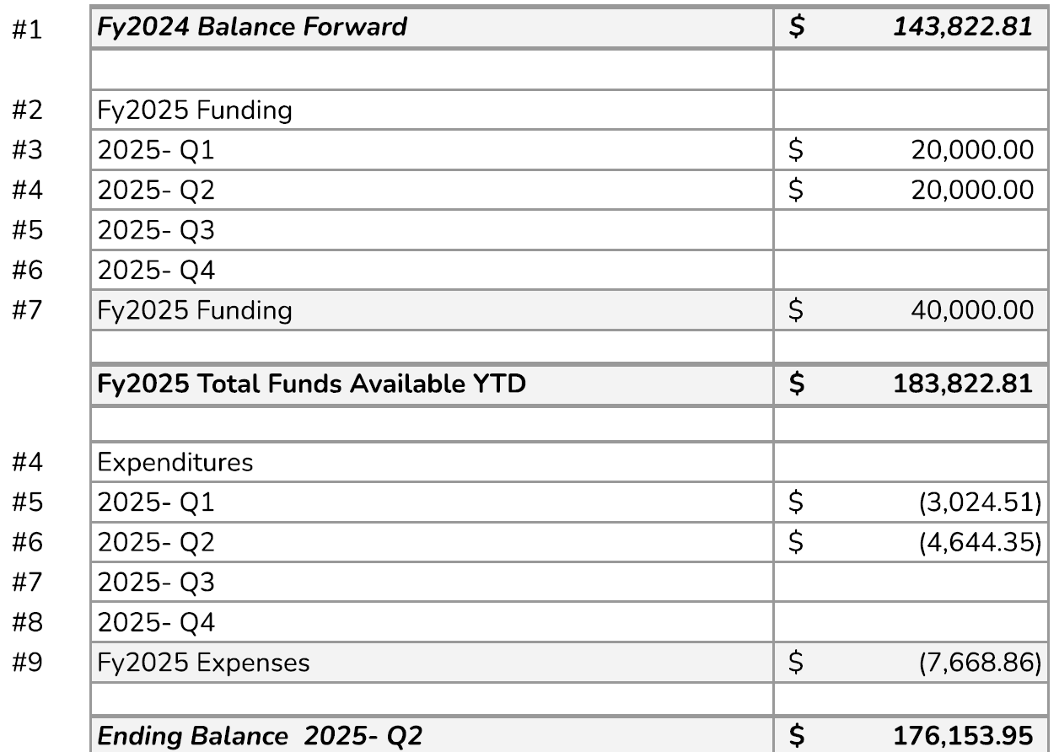
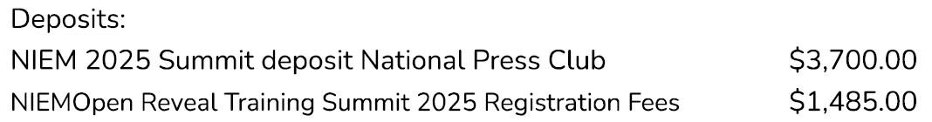
CY/FY 2025 Q2 FINANCIALS

Slide 19
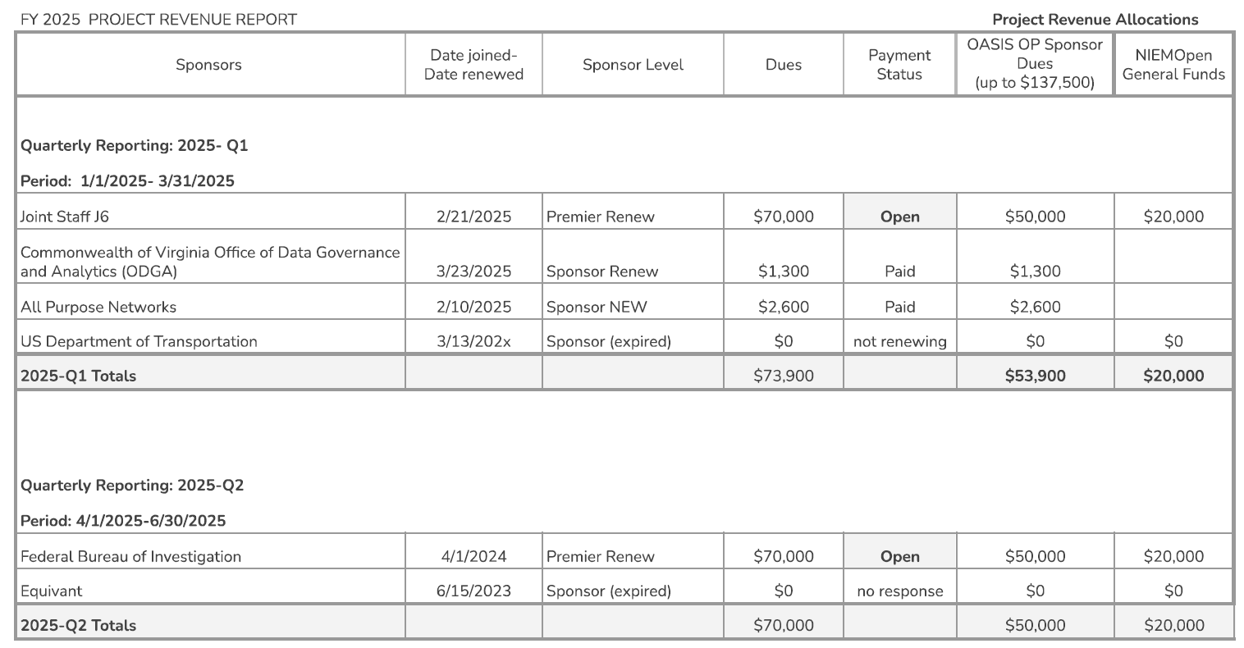
CY/FY 2025 Q2 FINANCIALS

Slide 20
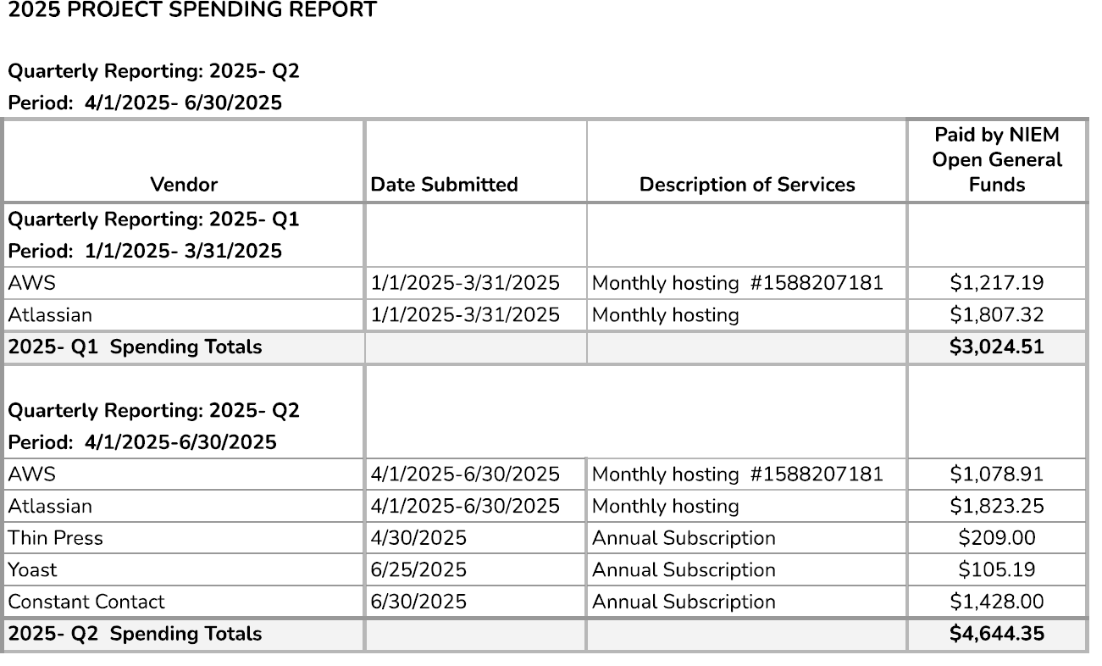
CY/FY 2025 Q2 FINANCIALS

Slide 21



























NIEMOpen Current Sponsors
10 Sponsors, 3 Premier
Sponsors
JS J6
DHS S&T
CJIS (FBI)
GTRI
NAJIS
BJS
IJIS
NIJ
APN
ODGA (Virginia)
Premier
Premier
Premier
All Purpose Networks, Inc.
Sponsors in the Offing
DHS
OBIM
Office of Standards
Department of National Defense

Slide 22

CY 2025 NIEMOPEN PLANNING
Complete
NIEMOpen NDR v6.0 Project Specification Draft (PSD01) Approved
NIEMOpen NDR v6.0 PSD01 Approved
Update Training Materials reflecting Model v6.0 PS and NDR v6.0 PSD01
Incorporate training updates into LearnPress LMS & test
IOC API 2.0 User tools
Conduct 22 May Webinar
Onboard Forensics Domain/ Sub-Committee
Conduct NBAC, NTAC & NMO Workgroup offsite (16-17 April 2025)
Stand-up NBAC. NTAC, NMO Workgroup
Execute OASIS- GTRI $100K Task Order for Developer Support
Planned/ In Progress 2025
Elect new PGB Chair
Transition NMO Roles & Responsibilities
Advance NDR PSD01 to a PS
Identify & approve 3 Statements of Use for Model Version 6.0 PS
Submit NIEM Model v6.0 PS02 as a Candidate OS
Complete API 2.0 model management tasks
Transition .gov website to NIEMOpen.org
Plan & Conduct 13 Nov 2025 Reveal Summit Webinar (IJIS Host)
Onboard Analytical Laboratories Domain\ Sub-Committee
Onboard Identity Management Domain/ Sub-Committee
Recurring & Future
Identify Potential Sponsors & conduct Outreach
Conduct Synch w/ OASIS Staff as needed
Complete transfer of github.io files to NIEMOpen
Start Model v6.1 (2026)
Achieve Model 6.0 as OS (2026)
Achieve Model 6.0 as ISO Standard (2026)
(28 Aug)
(29 Aug)

Slide 23
NIEM.gov MIGRATION
Previously Migrated - Prior NIEM Releases (zips and tars have been copied to OASIS repo)
In Progress:

Slide 24

BREAK

Slide 25
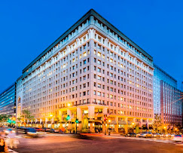

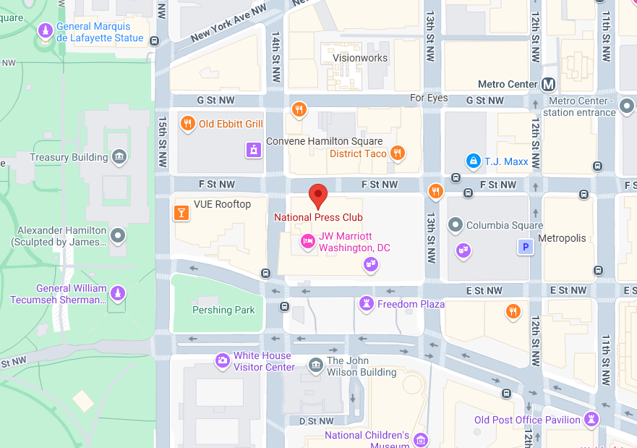
NIEMOpen Leadership Meeting National Press Club & Virtual
Date/time: 8 October 2025, ~ 9 AM – 4 PM
Venue: National Press Club & Virtual
529 14th St NW, Washington, DC 20045
“DRAFT” Agenda
Link for NBAC & NTAC Plenary Sessions: TBD
Link for AM & PM Joint Sessions & Q&A:
OASIS NIEM is inviting you to a scheduled Zoom meeting. Join Zoom Meeting https://us06web.zoom.us/j/8016452879?pwd=a3hNN0dieVJPR1pZY2QwbHVXbFJTUT09&omn=86251094933 Meeting ID: 801 645 2879 Passcode: 676136 One tap mobile +13052241968,,8016452879#,,,,*676136# US +13092053325,,8016452879#,,,,*676136# US
Supporting documents: https://github.com/niemopen/nbac-admin/tree/main/8-october-co-chair-meeting-npc

Slide 26
Reveal Summit Webinar
The IJIS Institute is hosting the virtual NIEMOpen Reveal Summit on November 13th , 2025 from 9AM to 4PM EST.
IJIS link for registration: NIEMOpen Reveal Summit Webinar
Supporting document repo:
https://github.com/niemopen/nbac-admin/tree/main/2025-reveal-summit
Ms. Teri Takai, a leader in information technologies and digital government, and Mr. Kshemendra Paul, first director of NIEM, have graciously agreed to keynote the event.
The Summit highlights use cases from the field where developers have adapted NIEM to solve contemporary information exchange problems.
While the final agenda is still a work in progress, several topic areas stand out:
Agenda Highlights “Strawman”
Keynotes: Teri Takai & Kshemendra Paul
Gust speaker: Information Sharing Standards: Dr. Kristen Honey
The New NIEM 6.0 & Tooling – Dr. Scott Renner
OASIS Executive Director -
JSON Demo – Brad Bolliger
Shaping NIEMOpen for the Future – Brad Bolliger
Voices from the Field – Ms. Maria Cardiellos
NIEMOpen Awards

Slide 27
Motions
PGB TOPICS FOR CONSIDERATION & VOTE
Motion to nominate & elect new PGB Chair (s).
Motion to authorize $ 2000 for 8 October NPC Leadership Meeting.
Motion to approve PGB Meeting dates.

Slide 28
Motion to Nominate & elect PGB Chair(s)
Chair: Nominations for a new PGB Chair are open.
Maker: (Chair – Ms. Katherine Escobar) I motion that nominations for a new PGB Chair (s) be entertained, and a Full Majority Vote taken to elect.
Full Majority Vote: “Full Majority Vote” is a vote in which more than 50% (more than half) of the eligible voter's vote “yes.” If the vote is held in a committee meeting, more than 50% of the total eligible voters must vote “yes” regardless of the number of present. Abstentions are not counted- https://www.oasis-open.org/policies-guidelines/oasis-defined-terms-2018-05-22/#dFullMajority
SECOND?
Chair: Discussion
Chair: Are there nominations from the floor?
Chair: Records nominations.
Chair: Conducts a Full Majority Vote
Chair: Announces Vote
Requires 6 yeas
Resolution
?
Approve
Approve w/Comment
Table/Reject
Notes:
1. The Chair (Maker- Katherine Escobar) makes a motion: I motion that nominations for a new PGB Chair (s) be entertained, and a Full Majority Vote taken to approve.
2. Another member seconds the motion – SECOND
3. Chair: “It is moved and seconded to adopt the motion.
4. Chair: Are there objections?
5. Chair: Those in favor of adopting the motion to approve say ‘Aye.’ [pause] Those opposed, say ‘No.’”
6. Chair: Announce the result
If no objections
7. Chair: Without objection, approved
8. Chair: Before we entertain nominations, I open the floor for discussion.
9. Chair: Are their nominations for a new Chair (s)? / nominations recorded.
10. Chair: Conduct the Vote
11. Chair: Those in favor of adopting the motion to approve say ‘Aye.’ [pause] Those opposed, say ‘No.’”
12. Chair: Announce the result.

Slide 29
Words from the newly elected chair

Slide 30
Motion to authorize $ 2000 for 8 October NPC leadership Meeting
Chair: In May, the PGB approved $ 6000 from the NIEMOpen general fund for refreshments, snacks, swag and AV services for the NIEMOpen Reveal now scheduled for 13 November as a Webinar.
The NPC location (sunk cost) was retained for a Leadership and general member meeting on the 8th of October. The Reveal funds no longer required, request a portion of those funds (not to exceed $2K) be applied to the 8 October NPC event.
Maker: (PGB Chair) I motion that $ 2000 from the NIEMOpen general fund originally approved for the Reveal Summit be authorized for the October event and the remainder (~$4000) be returned to the general fund.
SECOND?
Chair: (Debate) Do any of the members have comments on the proposal?
Chair: Conducts a Simple Majority Vote
Chair: Announces Vote
Resolution
?
Approve
Approve w/Comment
Table/Reject
Notes:
1. The member (Ms. Beth Smalley) addresses the chair – “Madam Chairman”
2. The chair recognizes the member – “The chair recognizes Mr. Paul Wormeli”
3. The member (Maker-Ms. Beth Smalley) makes a motion: ) I motion that $ 2000 from the NIEMOpen general fund originally approved for the Reveal be authorized for the October event and the remainder ($4000) be returned to the general fund.
4. Another member seconds the motion – SECOND
5. Chair: “It is moved and seconded to adopt the motion.
6. The members debate the motion
7. Chair: Those in favor of adopting the motion to approve say ‘Aye.’ [pause] Those opposed, say ‘No.’”
8. Chair: Announce the result
If no objections
Chair: Without objection, approved

Slide 31
Motion to Approve PGB Meeting dates
Chair: A proposal to approve moving the 13 November 2025 PGB meeting to 4 December 2025 and establish the CY 2026 Q 1, 2, 3 & 4 PGB Meeting Dates was submitted as a readahead to PGB Voting Members.
Maker: (PGB Chair) I motion that the following PGB Meeting Dates be accepted:
SECOND?
Chair: (Debate) Do any of the members have comments on the proposal?
Chair: Conducts a Simple Majority Vote
Chair: Announces Vote
Deconflict with 13 November 2025 Reveal Summit Webinar
CY 2025 Meeting Dates
Q4 | DEC 4 | 2-4 PM | EST
CY 2026 Meeting Dates
Q1 | MAR 19 | 2 – 4 PM | EDT
Q2 | JUN 18 | 2 – 4 PM | EDT
Q3 | SEP 17 | 2 – 4 PM | EDT
Q4 | DEC 3 | 2 – 4 PM | EST
?
Resolution
Approve
Approve w/Comment
Table/Reject
Notes:
1. The member (Beth Smalley) addresses the chair – “Madam Chairman”
2. The chair recognizes the member – “The chair recognizes Beth Smalley”
3. The member (Maker-Beth Smalley) makes a motion – I motion the PGB approve the following PGB meeting dates for CY 2025:
January 30, 2025, 2-4 PM EST
April 24, 2025, 2-4 PM EDT
July 31, 2025, 2-4 PM EDT
October 28, 2025, 2-4 PM, EDT
4. Another member seconds the motion – SECOND
5. Chair: “It is moved and seconded to adopt the motion.
6. The members debate the motion
7. Chair: Those in favor of adopting the motion to approve say ‘Aye.’ [pause] Those opposed, say ‘No.’”
8. Chair: Announce the result
If no objections
Chair: Without objection, approved

Slide 32
UPDATES
TSC Updates
NTAC Update – Mr. Brad Bolliger & Dr. Scott Renner
NBAC Update – Kamran Atri

Slide 33
NTAC TSC UPDATE
NIEM NDR v6.0 PS01 Vote in Progress – completes 29 Aug
CMF Tool updates in progress
API 2.0 development continues
NEXT:
Provide Model Version 6.0 Statements of Use to PGB
Test API 2.0
OFFING
Recommend Model Version 6.0 to PGB as candidate OS
Start Model Version 6.1 with NBAC
Model Version 7.0 Vision

Slide 34
NBAC TSC UPDATE
Forensics Domain/Sub-Committee Onboarded
Assist Defense Forensics with content contributions
Solicit Statements-of-Use for NIEM Model v6.0
Onboard:
Analytical Laboratories Domain/Sub-Committee
Identity Management Domain/Sub-Committee

Slide 35








RESOURCES
Follow Us On Twitter
https://twitter.com/NI EMconnects?ref_src=t wsrc%5Etfw
Git Repos
https://www.niem.gov/
https://www.linkedin.c om/groups/1903175/p rofile
NIEMOpen: https://github.com/niemopen/
NTAC TSC
https://github.com/niemopen/ntac-admin
NBAC TSC
https://github.com/niemopen/nbac-admin
NIEMOpen Slack Channel: https://niemopen.slack.com/
https://niemopen.org/
https://www.youtube. com/channel/UCg9qV 22PXLBjG41hc-EwVrQ
IEPD/MEP REPO
Mailing Lists
MEP TOOL
NIEMOpen: https://lists.oasis-open-projects.org/g/niemopen
PGB: https://lists.oasis-open-projects.org/g/niemopen-pgb
NTAC TSC: https://lists.oasis-open-projects.org/g/niemopen-ntactsc
NBAC TSC: https://lists.oasis-open-projects.org/g/niemopen-nbactsc
CMF TOOL
NDR v6.0 PSD01
NIEM Model v6.0 PS02

Slide 36
PGB Meeting Schedule – Pending Approval
NEXT PGB Meeting
Thursday, 4 DEC 2025 TBD
Virtual Meeting 2 – 4 PM EST
Virtual: ZOOM
CY 2026 Meeting Dates
Q1 | MAR 19 | 2 – 4 PM | EDT
Q2 | JUN 18 | 2 – 4 PM | EDT
Q3 | SEP 17 | 2 – 4 PM | EDT
Q4 | DEC 3 | 2 – 4 PM | EST

Slide 37


ADJOURN
Chair: Do any of the PGB members or our attending guests have any questions?
Chair: Meeting Adjourned

Slide 38
BACKUPS

Slide 39















SPECIFICATION WORKFLOW AND TIMELINE
Request a spec template from OP Admin
Decide on editor(s)
Editor’s job is to capture the intentions of the project team/TSC
Editor’s Manual starting at https://docs.google.com/document/d/1lTartcAzlqidzrCxuXFFiwdRDKRipqMnNsMS24SZdjg/edit
Create Project Specification Draft (PSD)
PGB can decide to advance PS to OASIS for consideration as an OASIS Standard
Requires 3 Statements of Use and a Special Majority Vote run by OP Admin
60-day public comment period
The Project Specification (PS) is put to OASIS Members in a 14-day Call for Consent. If no objections, work becomes an OASIS Standard, eligible for submission to other SDOs
PSD produced with oversight of TSCs
TSC recommends PSD to PGB
PGB requests Special Majority Vote be run by OP Administrator
Project Specification Approved by PGB
PGB approve PS as Candidate for OASIS Standard
OASIS Standard approved by members under Call for Consent
PS has the same standing as an OASIS Standard
7 days minimum - 2/3 must vote yes, no more than 1/4 nay votes
OP Admin publishes PS to the
library and announces/promotes
Project Specification Draft(s)^{1,3}
60 Day Public Review/ Comment
DRAFT PSD
PS PGB
Approval²
PS Candidate OS
PGB
Approval²
Call for Consent
OASIS Standard
PGB
2
Approval
14 Days Notice of Vote
14 Days Notice of Vote
3 Statements of Use
GitHub Repo
OASIS Project Library docs.oasis-open- projects.org
Special Majority Vote 7 Days
Working Draft 3-12 Months
Statements of Use 1-6 Months
2-3 Weeks Publish Candidate Standard
60 Days
14 Days
Publication & Announcement 1-2 Weeks
23

